Slide 1
CSC 2114: Artificial Intelligence
Introduction
Notes:
Please retain proper attribution and the reference to ai.berkeley.edu. Thanks!

Slide 2
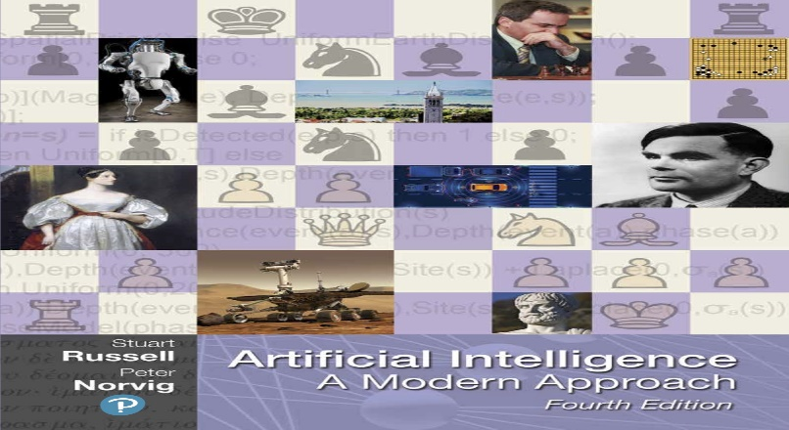
Textbook
Russell & Norvig, Artificial Intelligence: A Modern Approach, 3rd Ed.

Slide 3
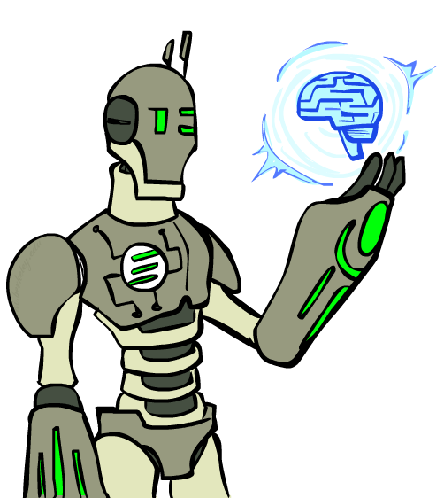
Today
What is artificial intelligence?
Where are we and how did we get here?
How do we think about the design of AI systems?

Slide 4
What is Artificial Intelligence
Is a branch of science that deals with helping machines find solutions to complex problems in a more human like fashion
Involves borrowing characteristics from human intelligence, and applying them as algorithms in a computer system.
Notes:
You can type into chat when you recognize the robot (just once!)
C3PO, what does he do? Essentially google translate, (but with anxiety disorder!)
R2D2 – what does he do, yeah, not so sure
These are all good

Slide 5
Artificial Intelligence view Perspectives
Intelligence perspective – Making intelligent machines acting like we would expect people to act.
Business perspective- provides a set of powerful tools and methodologies for using the tools to solve business problems.
Programming perspective- study of symbolic programming, problem solving and search.
Notes:
Futura/Maria
HAL
Termainator
Agent Smith
Ava

Slide 6
What is the definition of AI Systems?
Systems that think like humans | Systems that think rationally
Systems that act like humans | Systems that act rationally

Slide 7
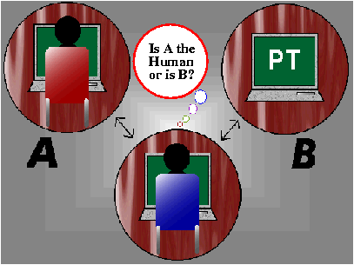
Approach 1: Acting Humanly
Act like a person
Turing test: ultimate test for acting humanly
Computer and human both interrogated by judge
Computer passes test if judge can’t tell the difference

Slide 8
How effective is this test?
Agent must:
Have command of language
Have wide range of knowledge
Demonstrate human traits (humor, emotion)
Be able to reason
Be able to learn
Loebner prize competition is modern version of Turing Test
Example: Alice, Loebner prize winner for 2000 and 2001

Slide 9
Approach 2: Thinking Humanly
Think like a person
Requires knowledge of brain function
What level of abstraction?
How can we validate this
This is the focus of Cognitive Science ( investigation of the mind and Intelligence).
Notes:
What level of abstraction? Knowledge, circuitry, chemical?

Slide 10
Approach 3: Thinking Rationally
Model thinking like a logical process where conclusions are drawn based on some logic of symbolic logic.
What are correct arguments or thought processes?
Provided foundation of much of AI
Not all intelligent behavior controlled by logic
What is our goal? What is the purpose of thinking?

Slide 11
Approach 4: Acting Rationally
Act to achieve goals, given set of beliefs
Rational behavior is doing the “right thing”
Thing which expects to maximize goal achievement
This is approach adopted by Russell & Norvig

Slide 12
Foundations of AI
Philosophy
450 BC, Socrates asked for algorithm to distinguish pious from non-pious individuals
Aristotle developed laws for reasoning
Mathematics
1847, Boole introduced formal language for making logical inference
Economics
1776, Smith views economies as consisting of agents maximizing their own well being (payoff)
Neuroscience
1861, Study how brains process information
Psychology
1879, Cognitive psychology initiated
Linguistics
1957, Skinner studied behaviorist approach to language learning

Slide 13
A short prehistory of AI
Prehistory:
Philosophy (reasoning, planning, learning, science, automation)
Mathematics (logic, probability, optimization)
Neuroscience (neurons, adaptation)
Economics (rationality, game theory)
Control theory (feedback)
Psychology (learning, cognitive models)
Linguistics (grammars, formal representation of meaning)
Near miss (1842):
Babbage design for universal machine
Lovelace: “a thinking machine” for “all subjects in the universe.”

Slide 14
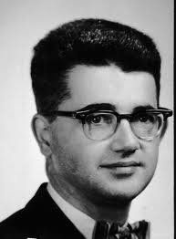
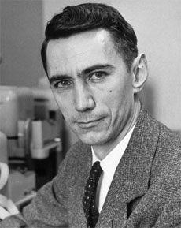
AI’s official birth: Dartmouth, 1956
“An attempt will be made to find how to make machines use language, form abstractions and concepts, solve kinds of problems now reserved for humans, and improve themselves. We think that a significant advance can be made if we work on it together for a summer.”
John McCarthy and Claude Shannon
Dartmouth Workshop Proposal

Slide 15
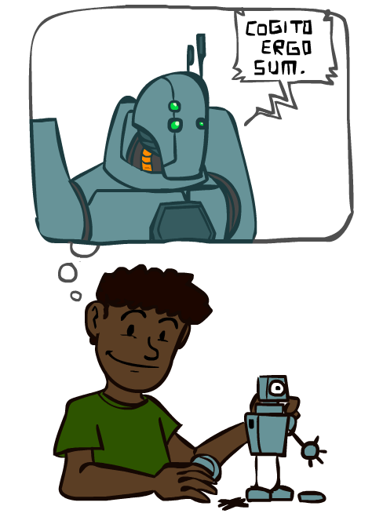
A (Short) History of AI
1940-1950: Early days
1943: McCulloch & Pitts: Boolean circuit model of brain
1950: Turing's “Computing Machinery and Intelligence”
1950—70: Excitement: Look, Ma, no hands!
1950s: Early AI programs: chess, checkers (RL), theorem proving
1956: Dartmouth meeting: “Artificial Intelligence” adopted
1965: Robinson's complete algorithm for logical reasoning
1970—90: Knowledge-based approaches
1969—79: Early development of knowledge-based systems
1980—88: Expert systems industry booms
1988—93: Expert systems industry busts: “AI Winter”
1990— 2012: Statistical approaches + subfield expertise
Resurgence of probability, focus on uncertainty
General increase in technical depth
Agents and learning systems… “AI Spring”?
2012— ___: Excitement: Look, Ma, no hands again?
Big data, big compute, deep learning
AI used in many industries

Slide 16
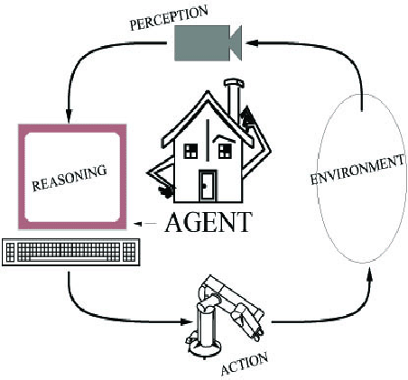
Rational Agents

Slide 17
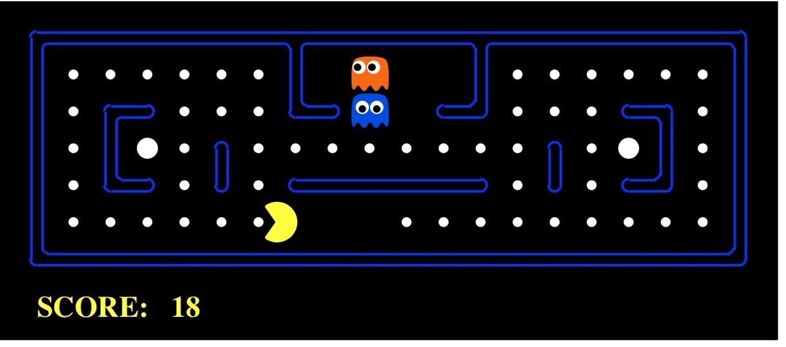
AI as Designing Rational Agents
An agent is an entity that perceives and acts.
A rational agent selects actions that maximize its expected utility.
Characteristics of the sensors, actuators, and environment dictate techniques for selecting rational actions
This course is about:
General AI techniques for many problem types
Learning to choose and apply the technique appropriate for each problem
Sensors
Percepts
Agent
Environment
?
Actuators
Actions
Pac-Man is a registered trademark of Namco-Bandai Games, used here for educational purposes

Slide 18
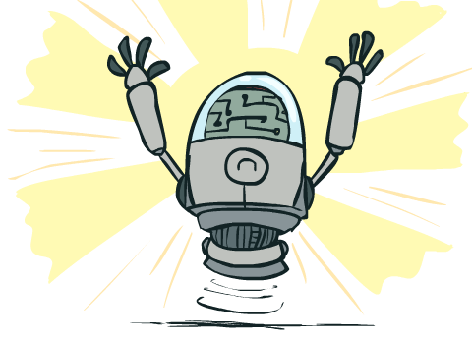
What Can AI Do?
Quiz: Which of the following can be done at present?
Play a decent game of table tennis?
Play a decent game of Jeopardy?
Drive safely along a curving mountain road?
Drive safely along Telegraph Avenue?
Buy a week's worth of groceries on the web?
Buy a week's worth of groceries at Berkeley Bowl?
Discover and prove a new mathematical theorem?
Converse successfully with another person for an hour?
Perform a surgical operation?
Translate spoken Chinese into spoken English in real time?
Fold the laundry and put away the dishes?
Write an intentionally funny story?
Notes:
Mountain road example: https://www.wired.com/2010/11/audis-robotic-car-climbs-pikes-peak/

Slide 19
Agents and environments
Agent
Environment
Sensors
Percepts
?
Actuators
Actions
An agent perceives its environment through sensors and acts upon it through actuators (or effectors, depending on whom you ask)
The agent function maps percept sequences to actions
It is generated by an agent program running on a machine

Slide 20
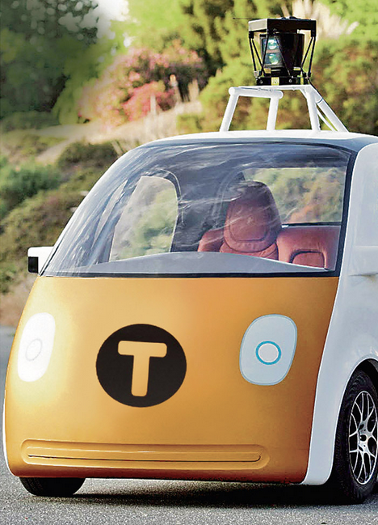
PEAS: Automated taxi
Performance measure
Income, happy customer, vehicle costs, fines, insurance premiums
Environment
Ugandan streets, other drivers, customers, weather, police…
Actuators
Steering, brake, gas, display/speaker
Sensors
Camera, radar, accelerometer, engine sensors, microphone, GPS
Image: http://nypost.com/2014/06/21/how-google-might-put-taxi-drivers-out-of-business/

Slide 21

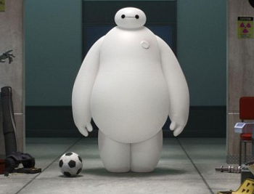
PEAS: Medical diagnosis system
Performance measure
Patient health, cost, reputation
Environment
Patients, medical staff, insurers, courts
Actuators
Screen display, email
Sensors
Keyboard/mouse

Slide 22
Environment Properties
Fully observable vs. partially observable
Deterministic vs. stochastic / strategic
Episodic vs. sequential
Static vs. dynamic
Discrete vs. continuous
Single agent vs. multi-agent
Known physics?
Known perf. measure?
Notes:
Fully observable vs. partially observable
Environment sensors provide access to complete state of the
relevant environment at each point in time
Deterministic vs. stochastic / strategic
If next state completely determined by current and action,
then deterministic, otherwise stochastic
If deterministic except for actions of other agents,
then strategic
Episodic vs. sequential
Episodic, action choice depends only on current state
Sequential, current action may affect future actions
Static vs. dynamic
Dynamic, environment can change while agent is deliberating
Discrete vs. continuous
Applied to state, time, percepts, or actions
The way the information is represented
Single agent vs. multiagent
How distinguish agent from environment?
if other's behavior maximizes its performance based on
agent, then it is multiagent

Slide 23
Agent design
The environment type largely determines the agent design
Partially observable => agent requires memory (internal state)
Stochastic => agent may have to prepare for contingencies
Multi-agent => agent may need to behave randomly
Static => agent has time to compute a rational decision
Continuous time => continuously operating controller
Unknown physics => need for exploration
Unknown perf. measure => observe/interact with human principal

Slide 24
Agent Types
Types of agents (increasing in generality and ability to handle complex environments)
Simple reflex agents
Reflex agents with state
Goal-based agents
Utility-based agents
Learning agent

Slide 25
Simple reflex agents
Use simple “if then” rules
Can be short sighted
SimpleReflexAgent(percept)
state = InterpretInput(percept)
rule = RuleMatch(state, rules)
action = RuleAction(rule)
Return action

Slide 26
Pacman agent program in Python
class GoWestAgent(Agent):
def getAction(self, percept):
if Directions.WEST in percept.getLegalPacmanActions():
return Directions.WEST
else:
return Directions.STOP

Slide 27
Reflex agents with state
Store previously-observed information
Can reason about unobserved aspects of current state
ReflexAgentWithState(percept)
state = UpdateDate(state,action,percept)
rule = RuleMatch(state, rules)
action = RuleAction(rule)
Return action

Slide 28
Goal-based agents
Goal reflects desires of agents
May project actions to see if consistent with goals
Takes time, world may change during reasoning
Notes:
Act to achieve a goal
Pro: use goal to index into actions that might achieve it, eg “Have milk” -> “buy milk”
Con: cannot handle tradeoffs among goals, failure probability etc.

Slide 29
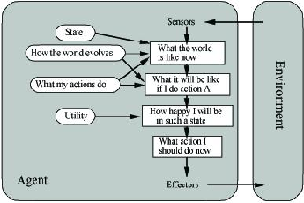
Utility-Based Agents
Evaluation function to measure utility f(state) -> value
Useful for evaluating competing goals

Slide 30
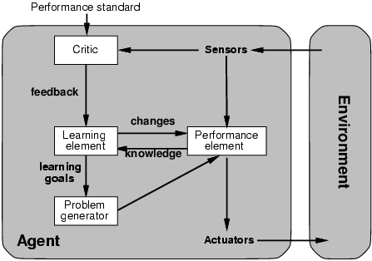
Learning Agents

Slide 31
Summary
An agent interacts with an environment through sensors and actuators
The agent function, implemented by an agent program running on a machine, describes what the agent does in all circumstances
Rational agents choose actions that maximize their expected utility
PEAS descriptions define task environments; precise PEAS specifications are essential and strongly influence agent designs
More difficult environments require more complex agent designs and more sophisticated representations

